Slide 1
LM6484 Stability Analysis
120pf 1X scope probe load

Slide 2
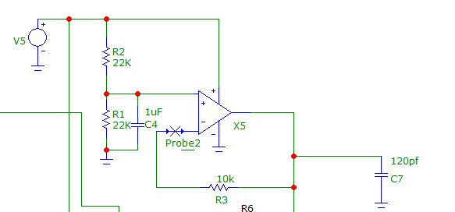
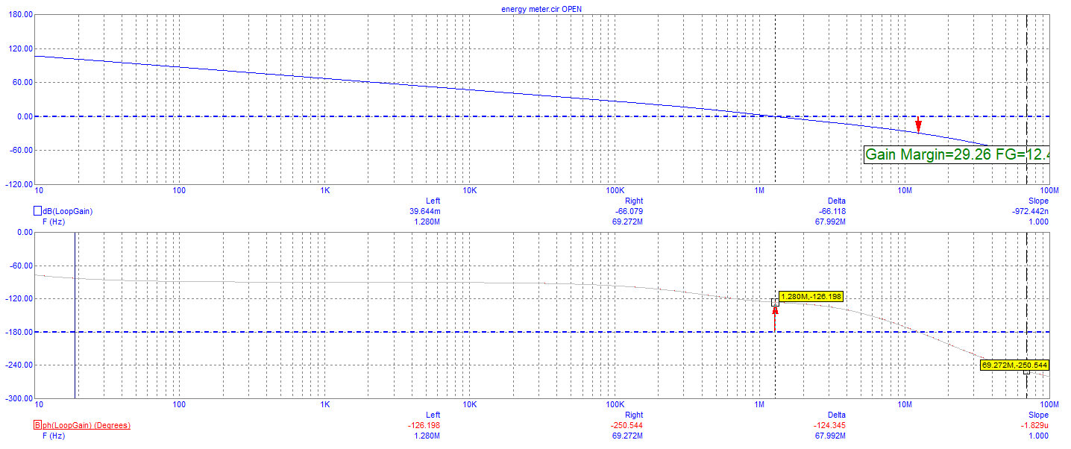
Virtual Ground Amplifier Stability as Designed
Phase Margin = 53.78°

Slide 3
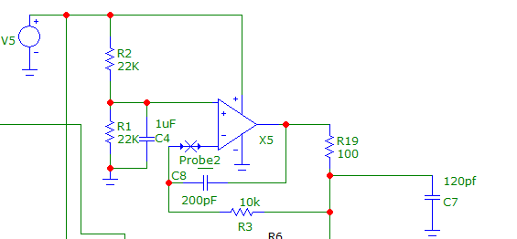
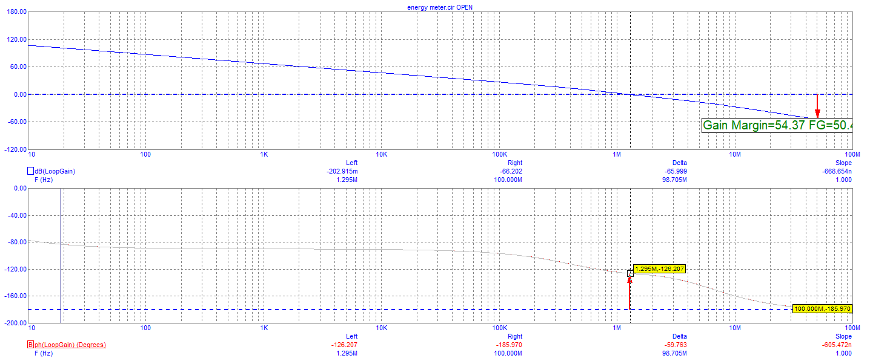
Virtual Ground Amplifier Stability with Capacitive Load Capability
Phase Margin = 53.9°

